Slide 1
C TA 1
variables, booleans, functions, output, globals

Slide 2
Variables

Slide 3
Variables & Memory
Variables are how we store values during a program run. In C (and other typed programming languages), we declare variables of a specific type. Only values that match the variable’s type can be assigned to the variable.
Recall that the memory consists of bytes, where each byte stores a value that is represented by a sequence of 8 bites. The types differ in their size, i.e. the number of bytes that store the variable value.
When declaring a variable (char x;), the computer allocates space in the memory where the variables data is stored, according to the variable’s type.
When the computer needs to use the data stored in the variable, it goes to the allocated place in the memory and retrieves the value stored there.
Let’s look at an example

Slide 4
Variables & Memory
x
y
0x0000
01000110
00000000 | 00000000 | 00000000 | 00001010
int main() { int x; char y; x = 10; y = 70; int z = x + y; return 0; }
0x0008
+
z
0x0016
00000000 | 00000000 | 00000000 | 01010000
0x0024
0x0032
0x0040
Notes:
Each cell is a byte

Slide 5
Variables - boolean
Boolean variables are variables that have a value of True or False.
There are no Boolean variables in C!
Instead, we use char/int:
Zero = False
Non-Zero = True
while (1) // true { }
if (-1974) // true { }
int i = (3 == 4); // i=0

Slide 6
Variables - boolean
#include <stdbool.h> #include <stdio.h> int main() { bool t = true; bool f = false; if (t != f) { // do something } return 0; }
In C99, the _Bool type was added
Notice – this is not really a primitive type, but a macro instead (more on macros later in the course)
Not really common – most C programmers use 0/1

Slide 7
Booleans – while loop example
int main() { int a = 5; while(1) { if(!(a-3)) { break; } a--; } return 0; }
When will the loop stop?
Never
a == 5
a == 3

Slide 8
For loop – the python equivalent
#include <stdio.h> int main() { int i; int j = 0; for (i = 0; i < 10; i++) { j += i; printf("%d %d\n", i, j); } return 0; }
j = 0 for i in range(10): j += i print(i, j)

Slide 9
Expressions as values
In C, almost all operators/expressions have a return value
The below code compiles and runs!
Will it run the code inside the if?
int i=0; if (i=5) { … }

Slide 10
Logical operators
Lazy evaluations – if the whole expression evaluation is known from the evaluation of the first boolean expression, the rest will not be evaluated. In this case, if i == 1, isValid() will not be called!
In python, we had “and”, “or” to evaluate more complex Boolean conditions.
In C, we use:
&& - logical “and”
|| - logical “or”
Sometimes, we want to perform operations between the binary representations of variable, for that we have bitwise operators:
& - bitwise “and”
| - bitwise or
int i=1; if (i==1 || x==isValid()) { //your code here }

Slide 11
sizeof()
As you have seen in the lecture, there are several primitive data types – char, short, int, long, float, double.
In C, we can create user-defined data types, called “structs” - we’ll get to that later in the course.
The number of bytes a data type is represented by in the memory is important for programming in C, as you’ll see later in the course.
To get the number of bytes (1 byte = 8 bits) of a data type (primitive or user-defined), we can call the “sizeof()” operator on it.

Slide 12
sizeof()
The operator returns a value which is unsigned long (or size_t, more on that in the next TA)
The operator accepts one argument which can be:
The data type, for example - sizeof(short)
Expression -
int a = 0, b = 10;
unsigned long s = sizeof(a + b);
The operator is a compile time operator – we can apply it only on sized that are known in compile time!
In C, there is only one constant in terms of size of data types - sizeof(char) = 1
It is also always true that sizeof(short) <= sizeof(int) <= sizeof(long)

Slide 13
Functions

Slide 14
Functions
Functions are the main part of a C program.
A function can have any name, if it doesn’t start with a number. The name “main” is a special name – the main function is what is being called when the program is run.
A function can be defined by the following syntax:
returnType functionName(type1 arg1) { //body of function return returnStatement }
Where returnType is the data type of what the function returns (for example, int), type1 is the data type of argument1 etc.

Slide 15
Procedures – functions that return void (nothing)
void foo(int a, int b) { // code... return; // optional! }

Slide 16
Function Declaration / Definition
void funcA() { } void funcB() { funcC(); } void funcC() { funcB(); }
Compilation error:
funcC is not known yet
A function only “knows” function
that were declared above it

Slide 17
Function Declaration
Declaration tells the compiler function name and return type
// the following 3 declarations are legit: int foo(int a); // return int accepts int int foo(int); // return int accepts int int foo(); // return int accepts unspecified parameters int main() { foo(5); return 0; } int foo(int a) // actual definition of `foo` { return a; }
Notes:
See: http://stackoverflow.com/questions/5929711/c-function-with-no-parameters-behaviour
The following code compile without a warning or error
#include <stdio.h>
#include <stdlib.h>
static void test1(int a, int b, int c) {}
static void test() { printf("HERE\n"); test(1,2,3); }
void main() { test(); }
In C++, void test() declares a function that takes no paramerers (and returns nothing).
In C, void test() declares a function that takes an unspecified (but not variable) number of parameters (and returns nothing). So all your calls are valid (according to the prototype) in C.
In C, use void test(void).

Slide 18
NO function overloading
int foo(int a) { return a; } int foo(int a, int b) { return a * b; } int main() { foo(5); return 0; }
A function may have several declarations, but only one definition
→ The following code will not compile
Notes:
http://david.tribble.com/text/cdiffs.htm#C99-odr
Note: C allows definitions of the same function or object in different source files to be composed of different token sequences, provided they are semantically identical.

Slide 19
Output

Slide 20
printf
Like “print” in python, printf allows us to print to the standard output (stdout). What will be printed here?
Unlike python, nothing is carried out for us! If we want a line break, we add “\n”
#include <stdio.h> int main() { printf("Hello World!"); printf("TA 1"); return 0; }
Hello World!TA 1

Slide 21
printf
The function prints a in a format - a string that contains the text to be written to stdout.
It can optionally contain embedded format tags that are replaced by the values specified in subsequent additional arguments and formatted as requested.
int main() { int x=3; printf("The value of x is %d",x); return 0; }
The value of x is 3
int main() { int x=3;
int y=4; printf("x is %d and y is %d",x ,y); return 0; }
x is 3 and y is 4

Slide 22
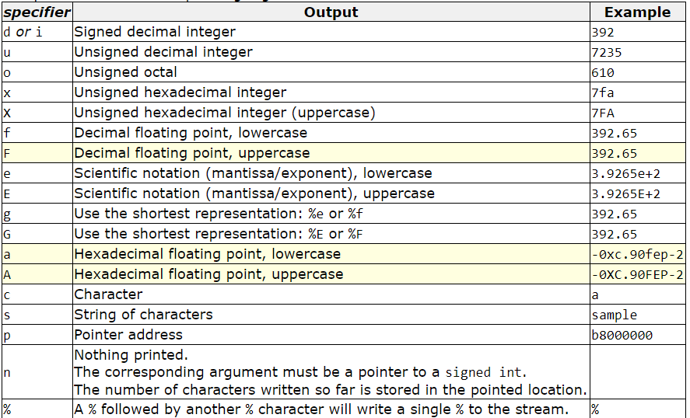
printf
It is important to specify the correct format for the variable, otherwise we will get prints we did not intend
When printing float and double we can choose the precision we want to print, by adding %.number to the format. For example %.3f will print a float number with precision of 3 digits.

Slide 23
printf
How can we print the value of variables?
What will be printed?
int main() { int x=3; printf("The value of x is %d",x); return 0; }
int main() { char x='a'; printf("The value of x is %c",x); return 0; }
int main() { char x='a'; printf("The value of x is %d",x); return 0; }
The value of x is 3
The value of x is a
The value of x is 97
How can we fix this and print ‘a’ as the value of x?

Slide 24
Global Variables

Slide 25
Global Variables
Global variables are variables that hold their values throughout the lifetime of the program, and they can be accessed by any function.
Global variables are defined outside a function, usually on top of the program.
#include <stdio.h>
int c;
int main () {
int a, b;
a = 10;
b = 20;
c = a + b;
printf ("a = %d, b = %d and c = %d\n", a, b, c);
return 0;
}
a = 10, b = 20, c = 30

Slide 26
Global Variables
If global and local have the same name, the value of local variable inside a function will take preference.
We can initialized the global variables. If we don’t, they are initialized automatically to a default value.
What will be printed?
garbage 5
garbage 10
0 5
0 10
#include <stdio.h>
int a;
int b = 5;
int main()
{
int b = 10;
printf("%d %d", a, b);
return 0;
}
What will be printed?
garbage 5
garbage 10
0 5
0 10

Slide 27
Global Variables
#include <stdio.h>
int a;
void foo()
{
a = 2;
}
int main()
{
printf("%d ", a);
foo();
printf("%d", a);
return 0;
}
0 2

Slide 28
Global Variables
Usually, we should avoid using global variables, and use them only when we have no other alternative. Why?
Global variables can be altered by any part of the code, making it difficult to remember or reason about every possible use.
A global variable can have no access control because it can not be limited to some parts of the program.
Testing in programs using global variables can be a huge pain.

Slide 29
Global Variables
You can use global variables when you want to define constants (magic numbers for example).
When we define a variable as const its value cannot be changed during the running of the program.
#include <stdio.h>
const int NUM = 5;
int main()
{
NUM = 10; // compilation error
printf(“My constant number is %d", NUM);
return 0;
}

